Slide 1
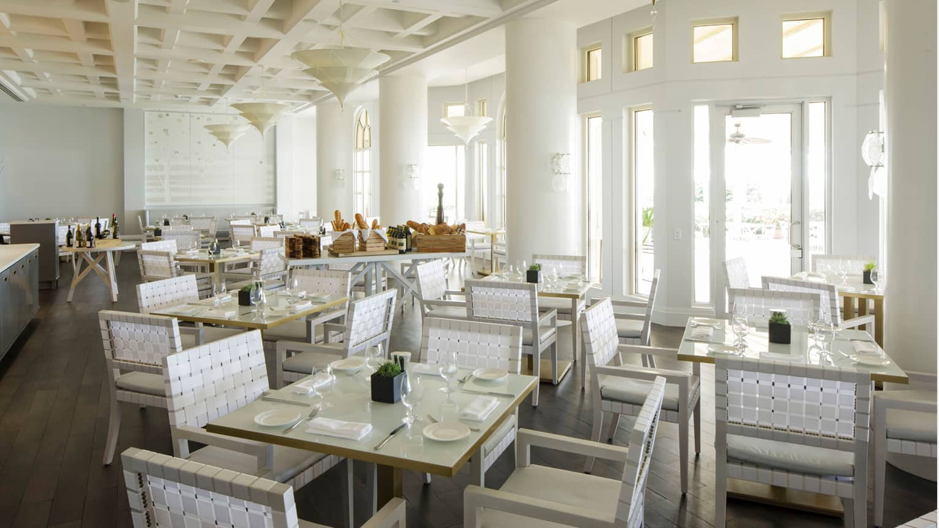
Store Location & Size Picker
Team members: Jianshan Yang(Thursday)
Parth Ved
Yanyu Wang(Thursday)
Yun Zhou

Slide 2
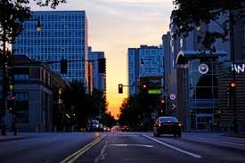
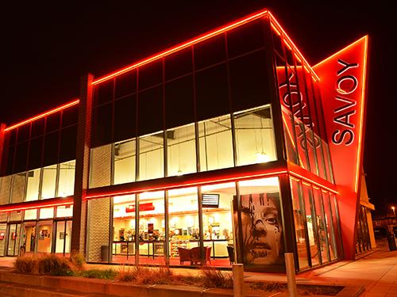
The pics of Green St and Savoy

Slide 3
Scenerio & Purpose
Scenerio
Nowadays, it is crucial to invest in the right properties which generate maximum profit
Investors are often confused and may take a wrong decision when selecting a location
Investors are often confused if they need to expand the restaurant when they saw a waiting list out of the restaurant.
Purpose
Help a restaurant owner to identify the best location to open a new restaurant
Help a restaurant owner to identify if the restaurant need to expand

Slide 4

Approach
Variables
Total number of customers for the resturant
Actual number of customers we served
Duration of customers stay
Profits for each person
Constant
Rent changed by size(tables)
Formula: Total_P = Σ profits - rent

Slide 5
Explanation for parameters
The distribution is mod_pert_random() function to create a distribution.Customers generator: 0-5 customers come in every period, while 2 has the highest frequency. The length of period is depended on location and time.
Stay time generator: 0-40 mins for lunch time, while 15 has the highest frequency; 0-70 mins for dinner time, while 40 has the highest frequency.
Profit per customer: 0.5-8 for lunch, 2 has the highest frequency; 2-12 for dinner, 5 has the highest frequency
Random out for customers after 15 in the waiting list
Size will effect on waiting pool and the number of served customers
Rent changed with size(determind by tables, using linear relation)

Slide 6
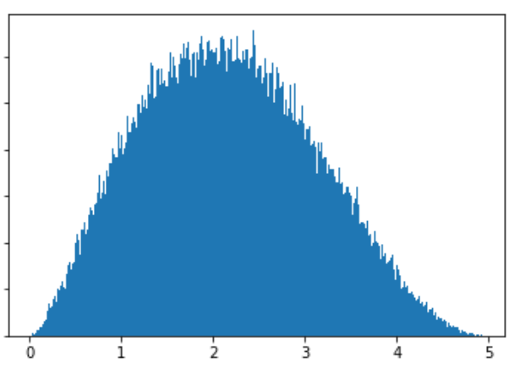
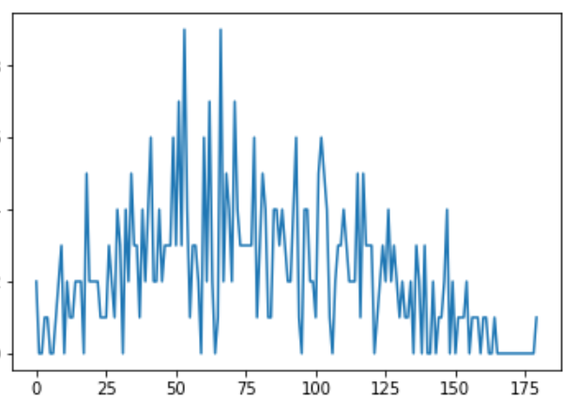
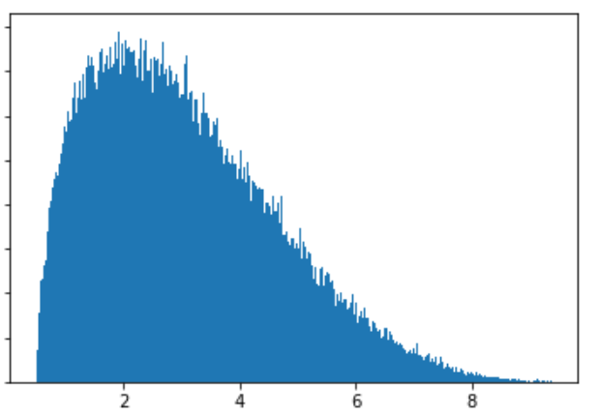
Data distribution examples
Customers distribution with numbers
Customers distribution with times
Profit per customer

Slide 7
Assumptions
We assume that the two places we choose are different between weekdays and weekends.
Customers will prefer to spend more time on dinner than lunch.
The profit (per person) will be more for dinner than for lunch.
The rental fee only related to the location and the size for the restaurant.
The time customers spend in the restaurants will be in a range we set.

Slide 8
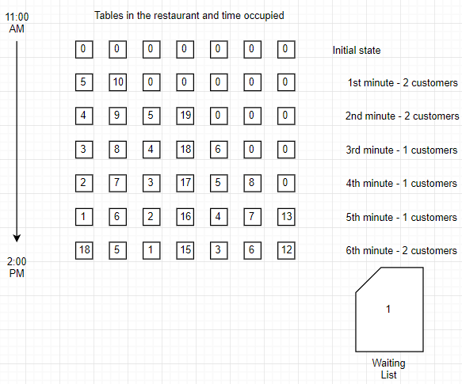
Workflow

Slide 9
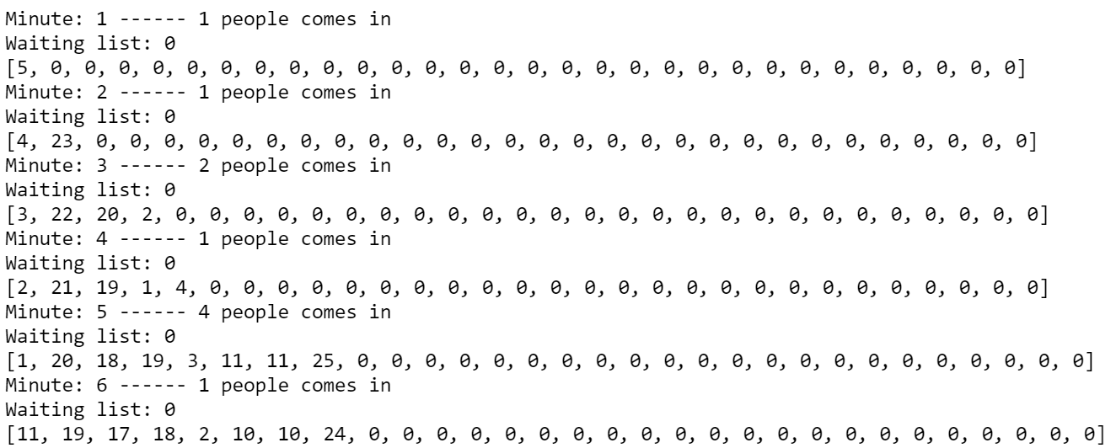
Example: Customer out and in

Slide 10
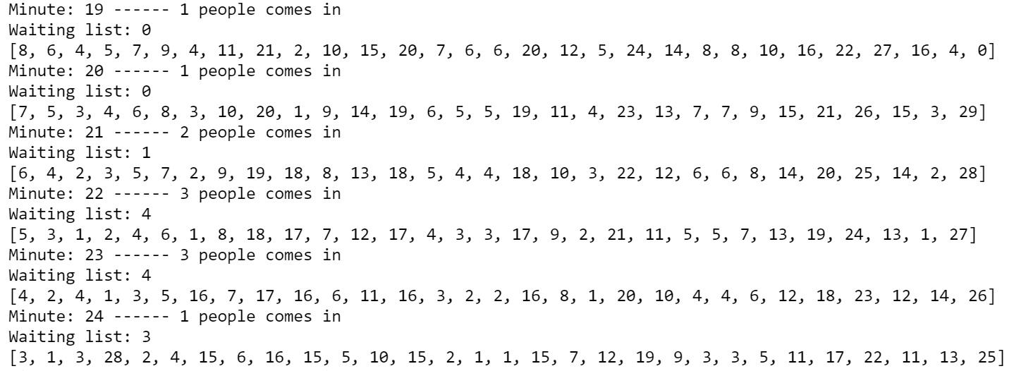
Example: Full and waiting list

Slide 11
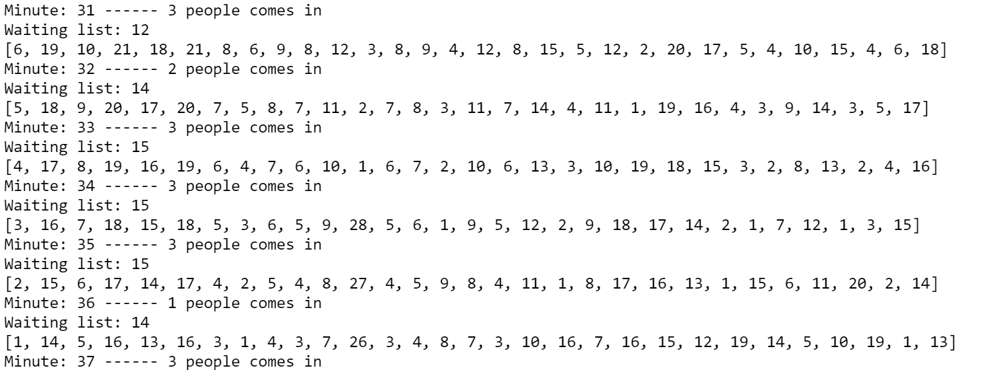
Example: Customers in and leave

Slide 12
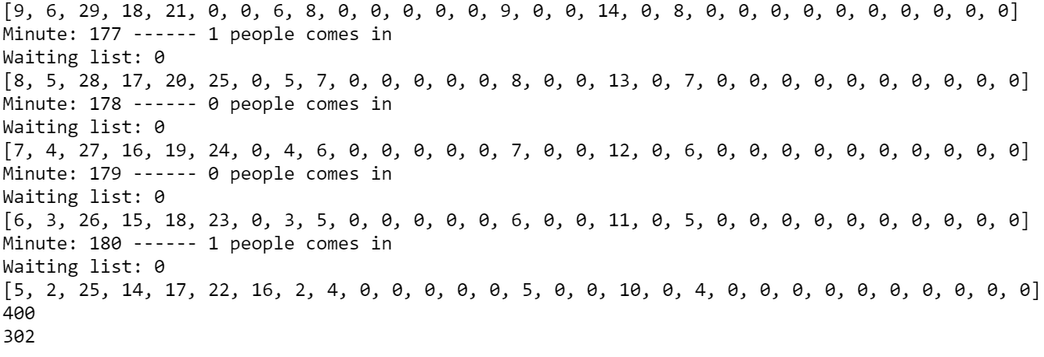
Example: Total customers

Slide 13

Thank you!

